Slide 1

Berkeley Police Data
Amy Zhu, Mengyu Li, Rebecca Reus, and Shangjun Jiang

Slide 2
Motivations
First, it’s Berkeley local data. Go Bears!!!
Stop/ Arrest/ Jail Book/ Call for service data reals different aspects of Berkeley safety condition. It’s one of the factors we care most about Berkeley.

Slide 3
Questions
What’s the most dangerous place in Berkeley?
What’s the most dangerous time in Berkeley in a day?
Does Berkeley PD indicate any tendency of arresting a specific group during stop?

Slide 4
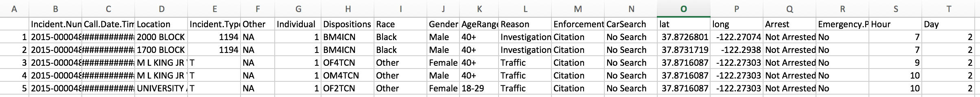
Stop Data Cleaning
Separate original disposition into number of an individual, race, gender, age range of the individual, enforcement and reason of the stop, car search information and additional dispositions for analysis purpose.
Converting literal address to longitude and latitude for the convenience of drawing maps.

Slide 5
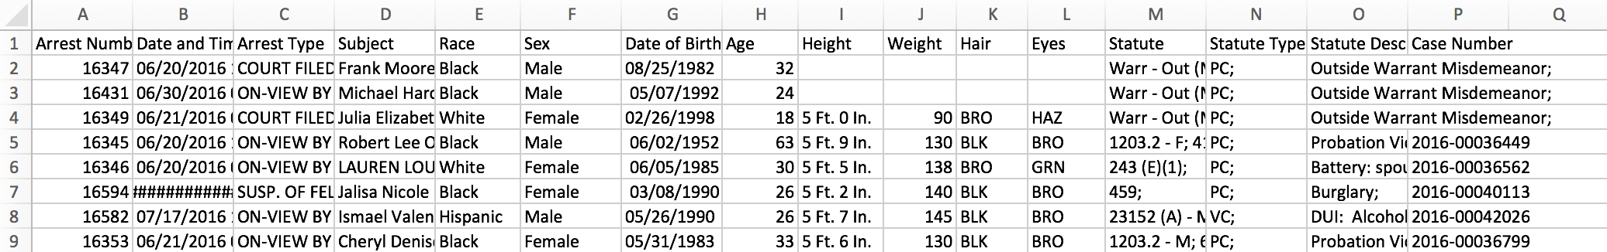
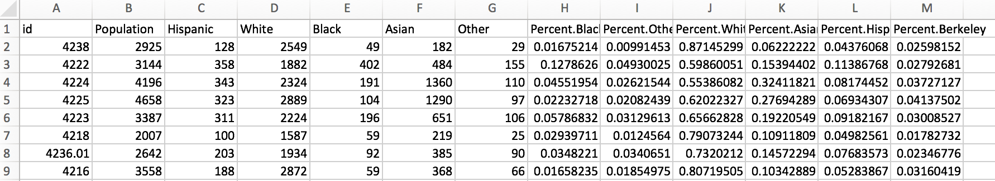
Other Dataset Cleaning
Jail (30 days)
Arrest (30 days)
Calls for Service (180 days)
Census (2000 + 2010)

Slide 6
Problems of data
In further regards to the racial data available, it is important to note that the census data we used to compare the stop data to included many more categories for race than just the five used by police (Asian, Black, Hispanic, Other, and White).
Secondly, the police data used in this paper comes from a data set maintained by the City of Berkeley that is updated every 3 months (as is the case for arrests and jail bookings) or every 6 months (as is the case for stops
Next, with regard to the stop data in particular, the many data-entry problems we faced in the character string location column (which sometimes included only 1 street), there is likely some stops that are not mapped correctly due to approximations made by the Google geolocation service (for example, in some cases, only having one street name instead of a corner caused Google to estimate the exact location based on few conditions).

Slide 7
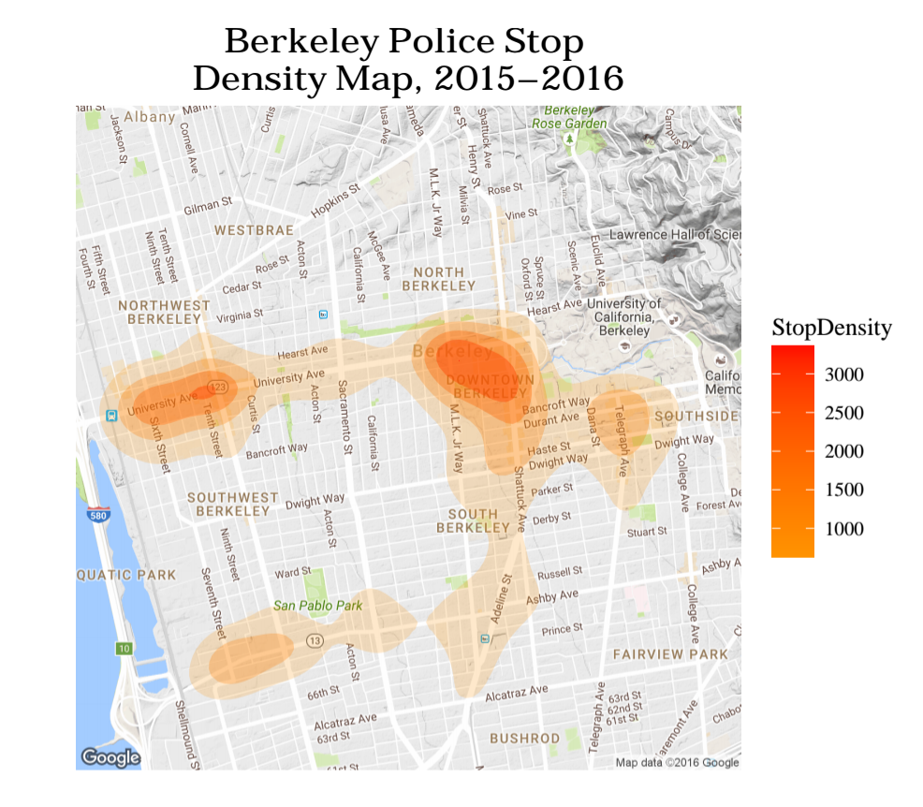
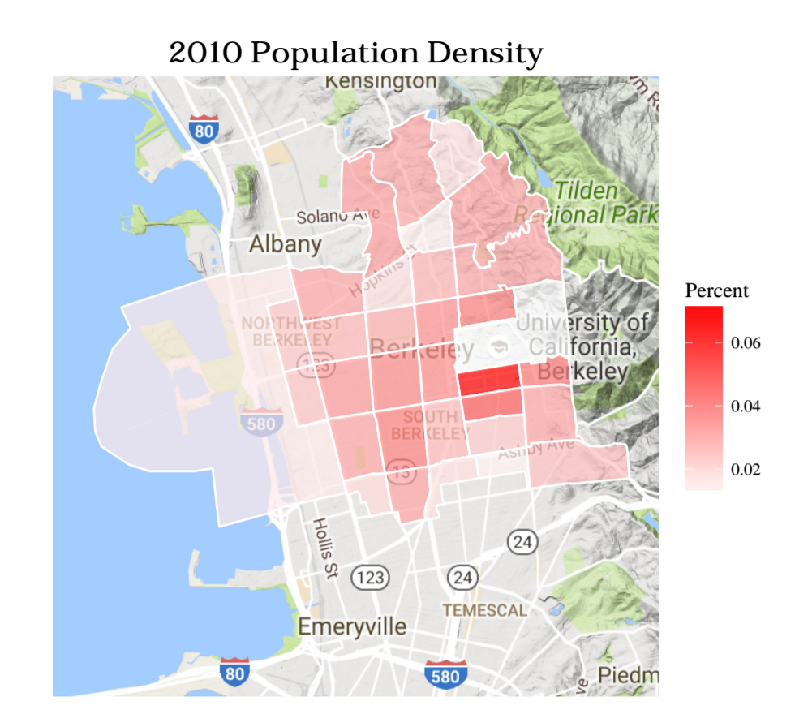
Berkeley PD Stop Density and Population Density

Slide 8
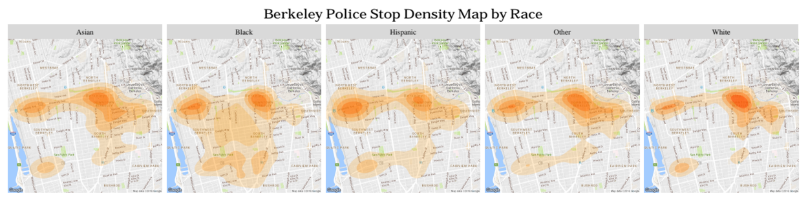
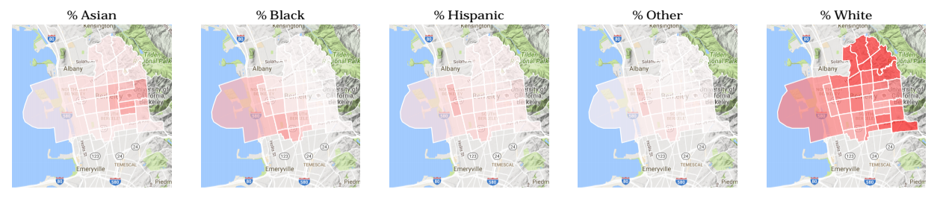
Stop and Population Density by Race

Slide 9
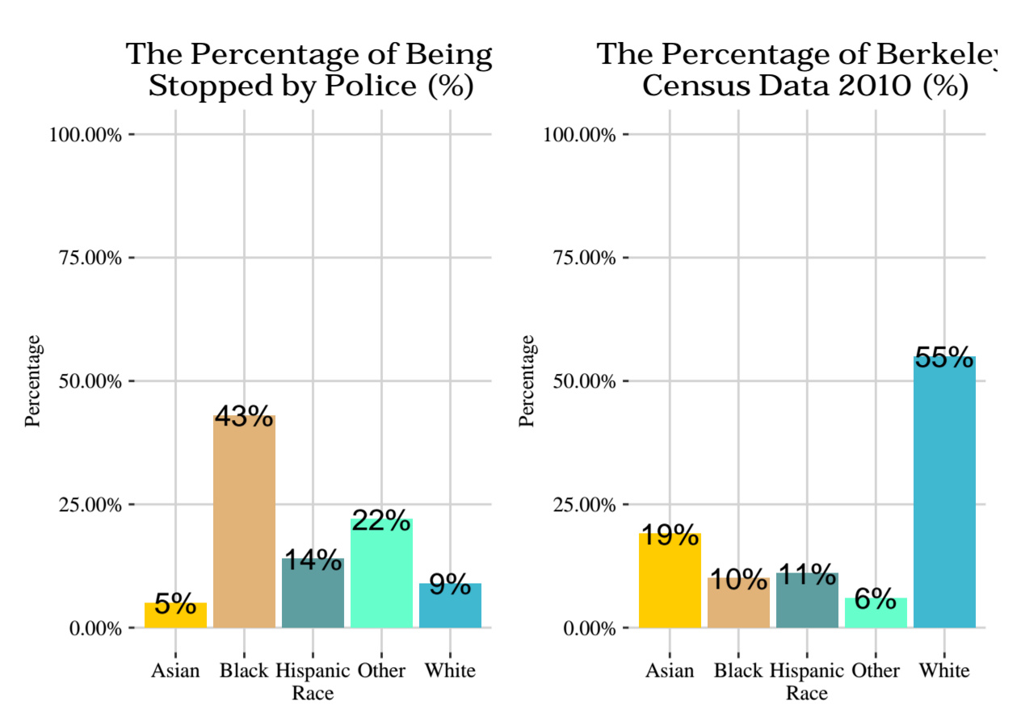
Percent Population Stop Percentage
Analysis
Although southside campus has the greatest population density, westside campus has the greatest stop density.
The majority to Berkeley population are white people, while Black people are most liable to affected by the stop.
Black people have a larger and sparser range of stop, while other races are more focused.

Slide 10
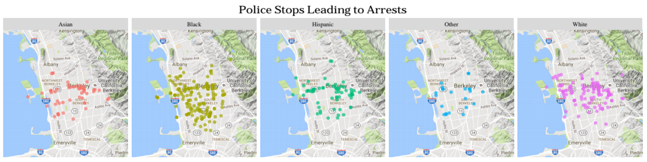
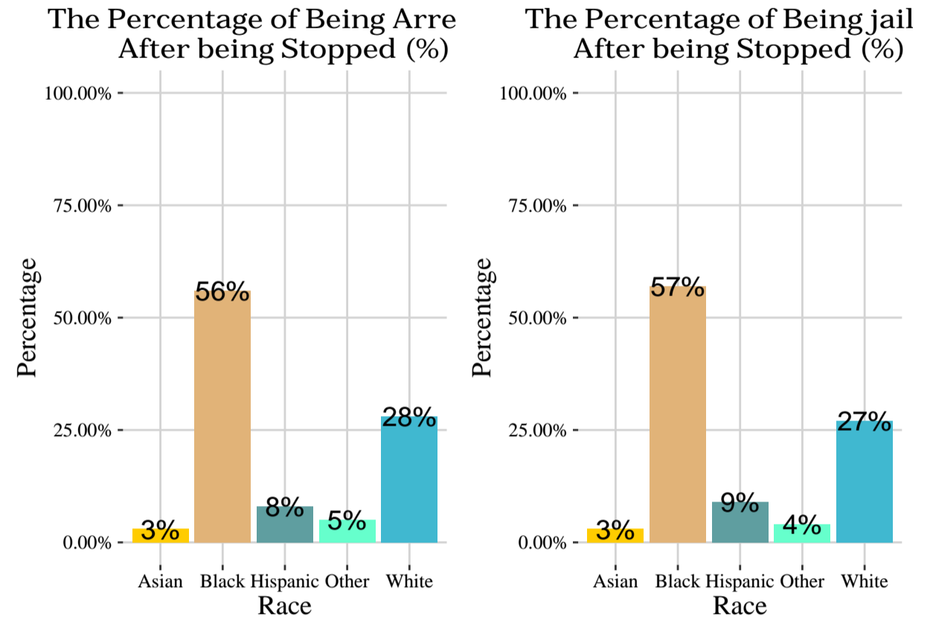
Arrest Ratio
Arrest Analysis
Analysis
The majority of people being arrested / jailed are black, while white people also contributes a negligible part.
Asian people are the lowest percentage of being arrested / jailed. This fact corresponds to the “model minority” stereotype of Asian.
These 2 charts are similar. We can deduce that after Berkeley PD arrests people, it always puts them into the jail.
22

Slide 11
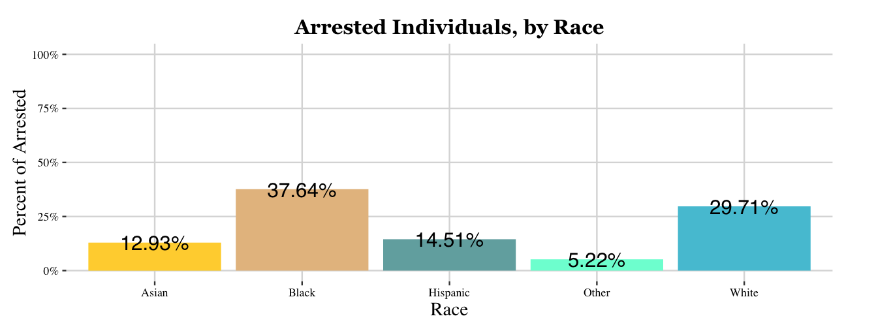
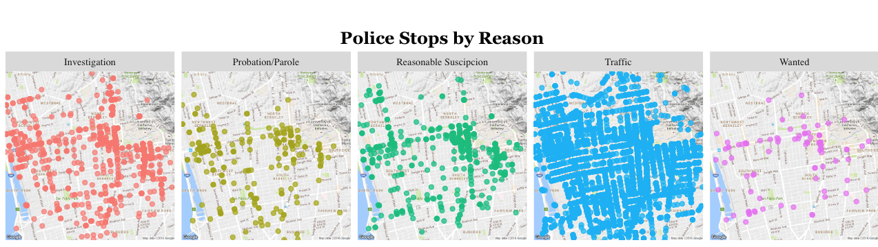
Being arrested after being stopped

Slide 12
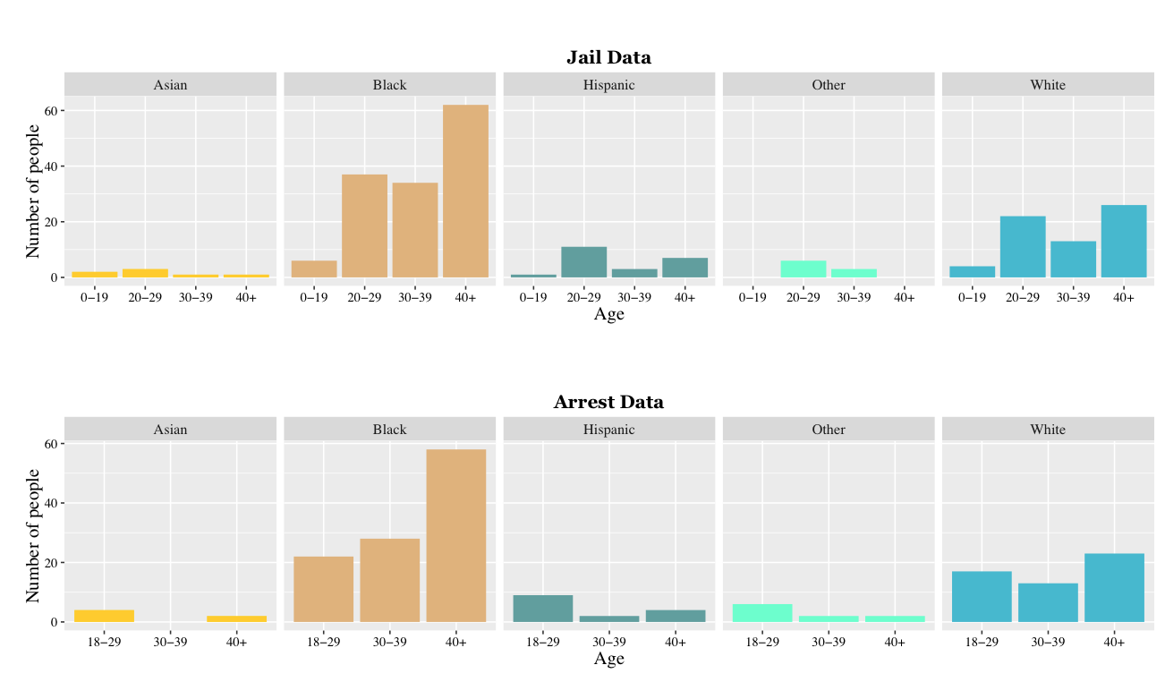

Slide 13
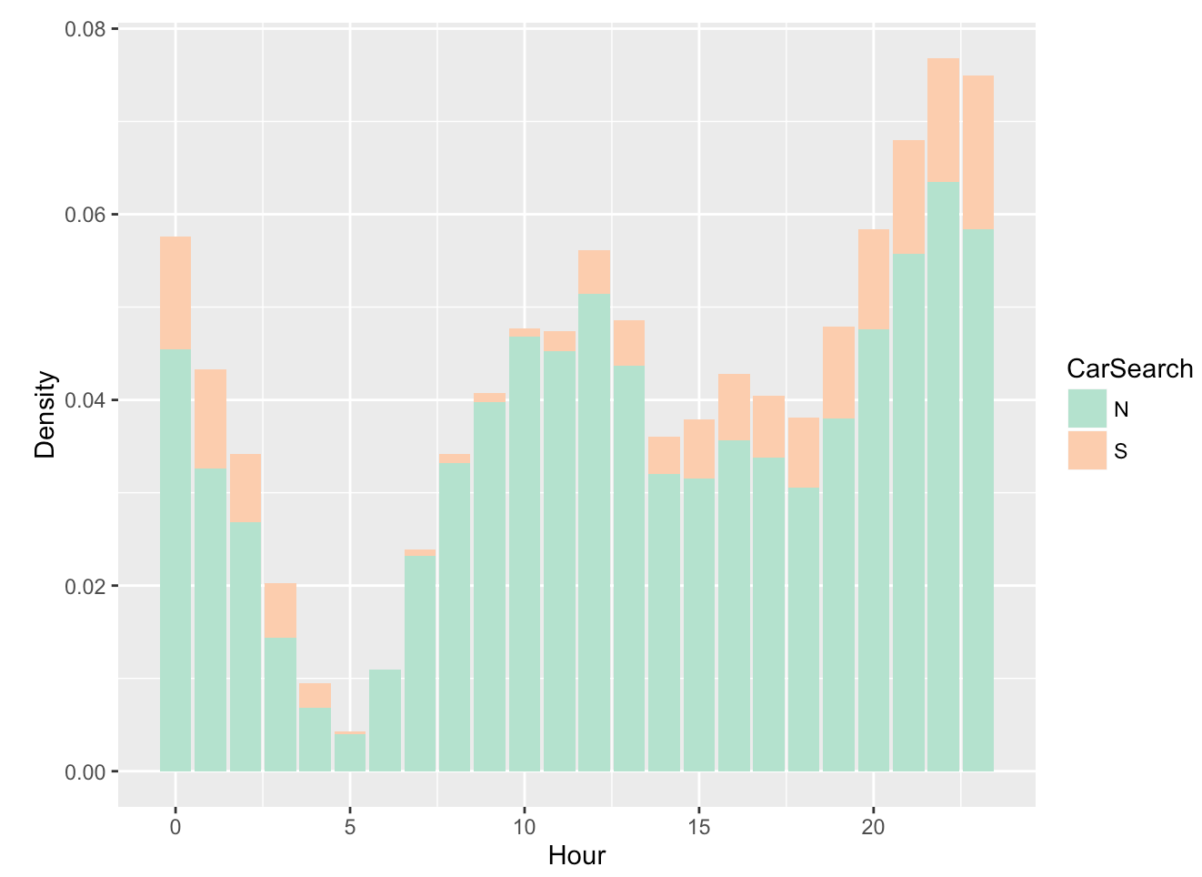
Hour Analysis
Density of Hour in a Day
From evening, incidents density keeps increasing and reaches the highest point in the midnight.
After midnight, incidents density decreases because people need to go to bed. The density of incidents increases in the morning since people start to wake up.
Berkeley PD is more liable to do car search at night.

Slide 14
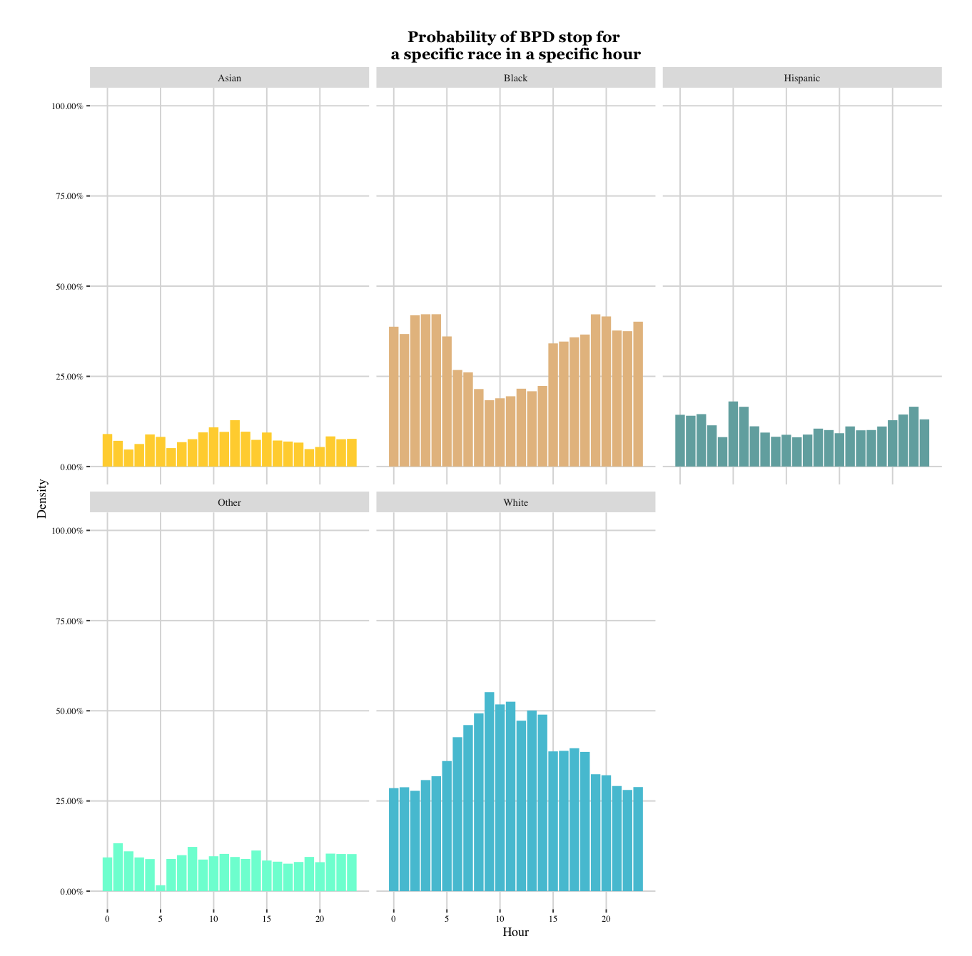
Analysis
P(Race | Hour)
Black people are more liable to be stopped at the night.
White people are more liable to commit incidents in the daytime.
Ratios of incidents committed by three other races fluctuate during the daytime and the night, with an average ratio of 8%, 11% and 9% respectively.

Slide 15
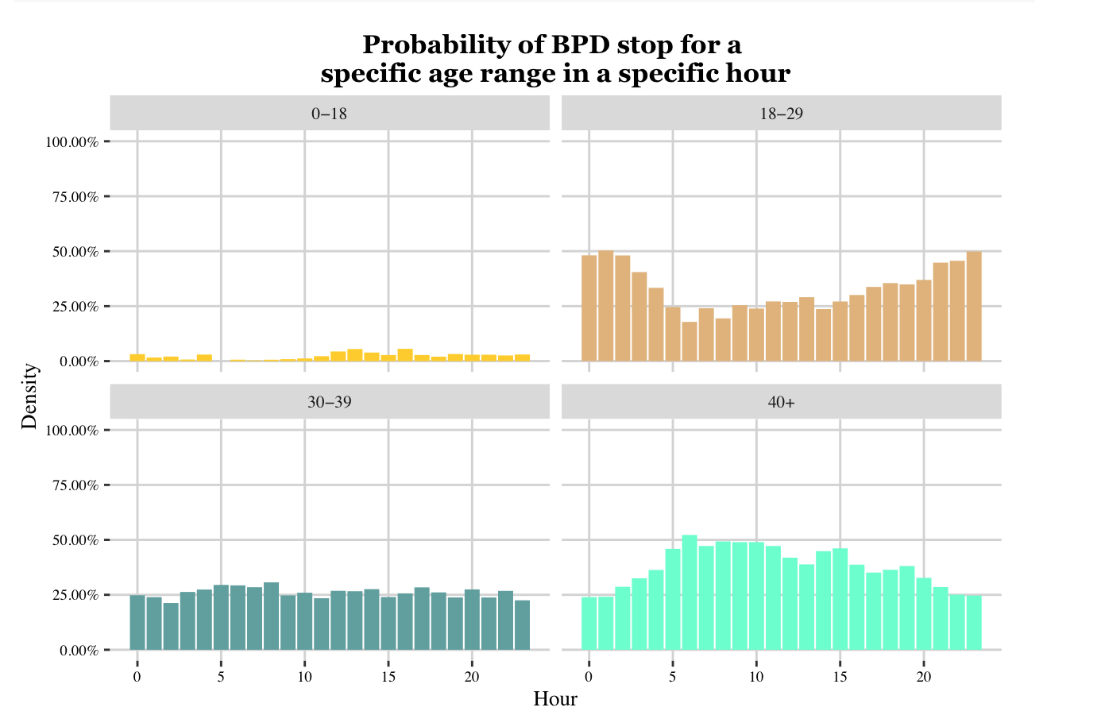
P(Age | Hour)
Analysis
People aged from 18 to 29 are obviously liable to commit incidents at night because young people are more likely to stay up to late.
People aged greater than 40 are easier to be stopped in the daytime for they need to participate activities during daytime.
People aged from 0 to 18 contribute the least percentage in any hour.

Slide 16
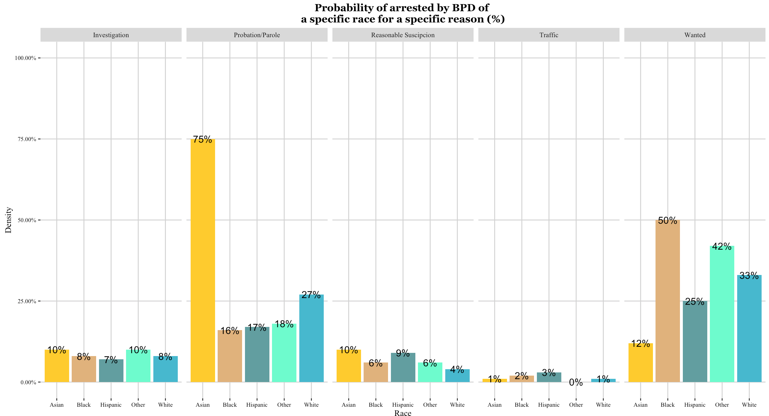
P(Arrested | Reason, Race)

Slide 17
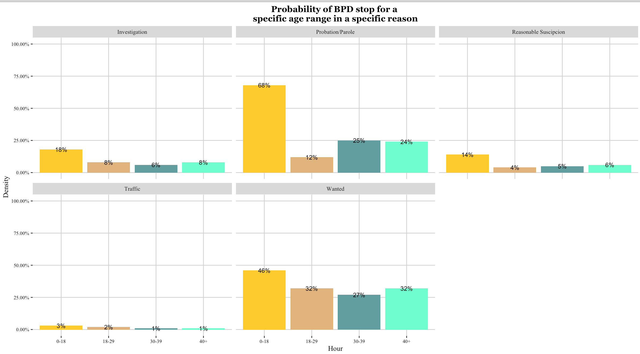
P(Arrested | Reason, Age Range)

Slide 18
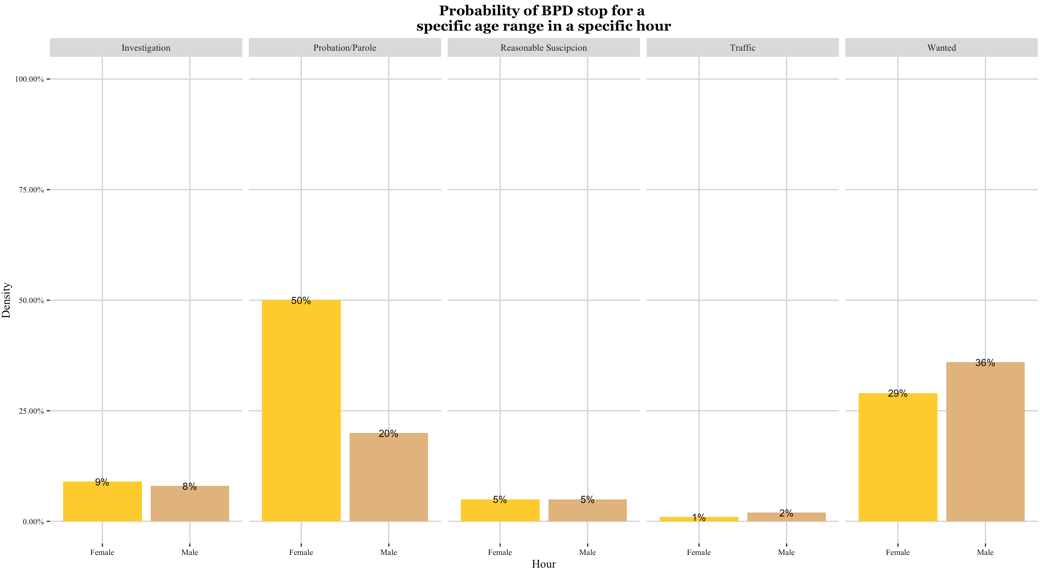
P(Arrested | Reason, Gender)

Slide 19
Analysis
The probability of arrested in a stop with the reason Traffic is the lowest and wanted is the highest.
An interesting fact is that the conditional probability of arrested in a stop with the reason Probation or Parole of female, Asian people and teenger(0 - 18) is obviously higher than any other group in their own chart.
The conditional probability of arrested given person involved aged from 0 to 18 in a stop given any reason is more than that of given person with any other age range. Therefore, in a stop, teenagers is more likely to be arrested by Berkeley Police Department.

Slide 20
Conclusions
Although our preliminary findings unfortunately seem to suggest that certain groups of people, especially black people, are disproportionately likely to be stopped, arrested, and jailed in the city of Berkeley, we recommend a more rigorous statistical analysis of the data be done in order to assess this claim.
We also recommend an idea we had for this project to future researchers that could make the Berkeley police data more accessible. For example, one could make the data more accessible by creating a shiny app that allows the user to toggle between the different dispositions of the data (race, age range, enforcement, reason, etc.) and between modes of view (map or bar chart, for example) or order to play with the data in a visual way.

Slide 21

What will we do next?
We can develop applications such as App to provide safety condition about a specific location according to time.

